Slide 1
RISING SCHOLARS 2024-2025
REGISTRATION
(Returning students)
THIS IS ONLY IF YOU ARE WANTING COLLEGE CREDIT

Slide 2
REGISTRATION DETAILS
WHAT: You can earn both high school and college credit with NSU Rising Scholars On-Campus classes.
WHAT: You can earn both high school and college credit with Rising Scholars and NSU On- campus Dual Enrollment classes (Speech).
WHY: Many credits will transfer at a less expensive rate. *Check your future school!
HOW: You must meet enrollment criteria, fill out registration, AND pay before deadline. YOU MUST KEEP UP WITH E-MAIL NOTIFICATIONS! This includes over the summer!
WHY: Many credits will transfer at a less expensive rate. *Check your future school or ask the NSU Academic Advisor what this may look like for you!
HOW: You must meet enrollment criteria, fill out registration, AND pay before deadline.
YOU MUST KEEP UP WITH E-MAIL NOTIFICATIONS! This includes over the summer!
COST: Rising Scholars is $40.00
per college credit.
SD BOR Dual Enrollment online is $50.84 per college credit.

Slide 3
Enrollment Requirements
*To qualify for college credits
Seniors
ACT composite or a Superscore of 21+ OR
Smarter Balance Level 3+ on both English Language Arts and Math OR
Rank in upper 1/2 of class OR
Unweighted GPA of 3.25+
Juniors
ACT composite or a Superscore of 24+ OR
Rank in upper 1/3 of class OR
Unweighted GPA of 3.5+
You first must qualify for the program

Slide 4
Additional Testing Requirements (NSU will notify if testing is needed)
MI (Math Index) 1300+ OR GPA of 3.55+ AND Calc Accuplacer score of 19+ (MI is calculated using ACT score and GPA)
Calculus
College Algebra
MI (Math Index) 1150+ OR Smarter Balance MATH 2628+ OR
HS GPA of 3.03+
Composition 1 and Intro to Literature
Eng ACT 18+ OR Smarter Balance English 2583+ OR Accuplacer 263+
Composition I (ENGL 101) is a pre-requisite course for Intro to Literature (ENGL 210)
US History/Biology/Speech/Government
No additional requirement needed beyond enrollment requirements
****Math Index is a formula determined by SD BOR using your GPA
and ACT score.

Slide 5
GO to the NSU Rising Scholars website https://northern.edu/academics/high-school-programs/rising-scholars
Registration process
Returning Students
(For those that have previously taken college credit)
Select Registration
Expand the Registration box
Select Registration Form that applies to you.
Log in with your previous account information.
Complete all steps and submit the form electronically by the required deadlines. Ask your HS Counselor or NSU Academic Advisor if you don’t know these dates!
Your school official will send in transcripts and test scores to NSU. (Do not worry about test scores at this time.)
Once these steps have been followed (from the student, parent and high school), you will receive a confirmation email. This could take a period of time – so don’t panic if you don’t receive one right away.
Payment is NOT DUE until right before the start of the semester. More information will be available at that time.
Do NOT send payment to your high school!

Slide 6
CLICK Registration on NSU Rising Scholars Website https://northern.edu/academics/high-school-programs/rising-scholars

Slide 7
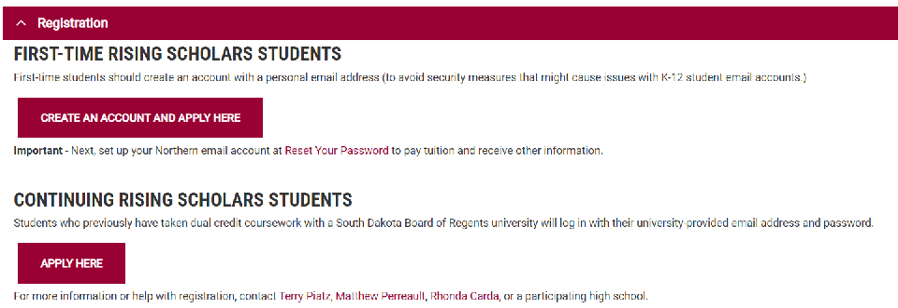
Expand the Registration Box
Select Continuing Rising Scholars Apply Here

Slide 8
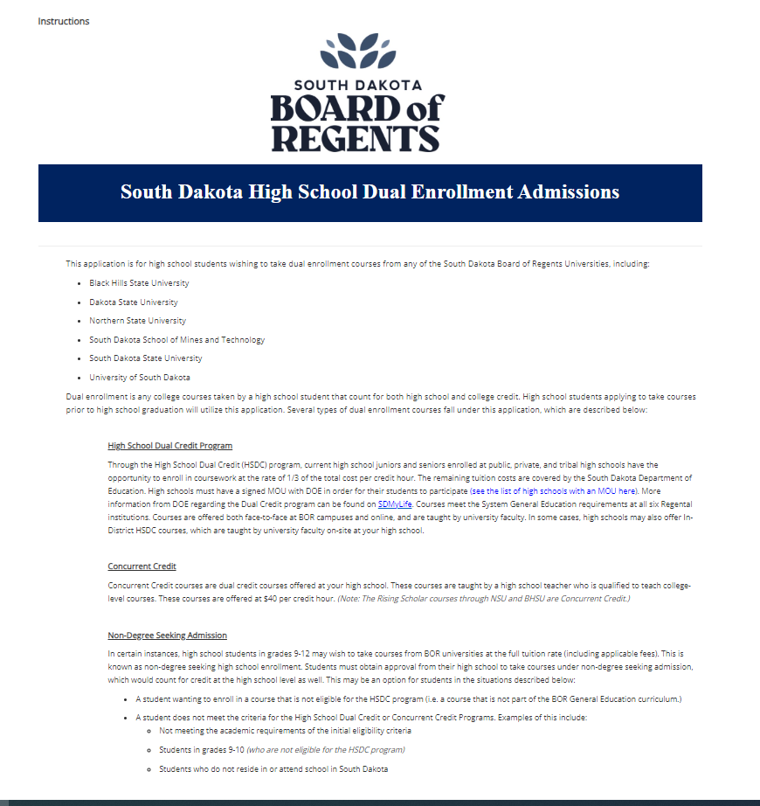
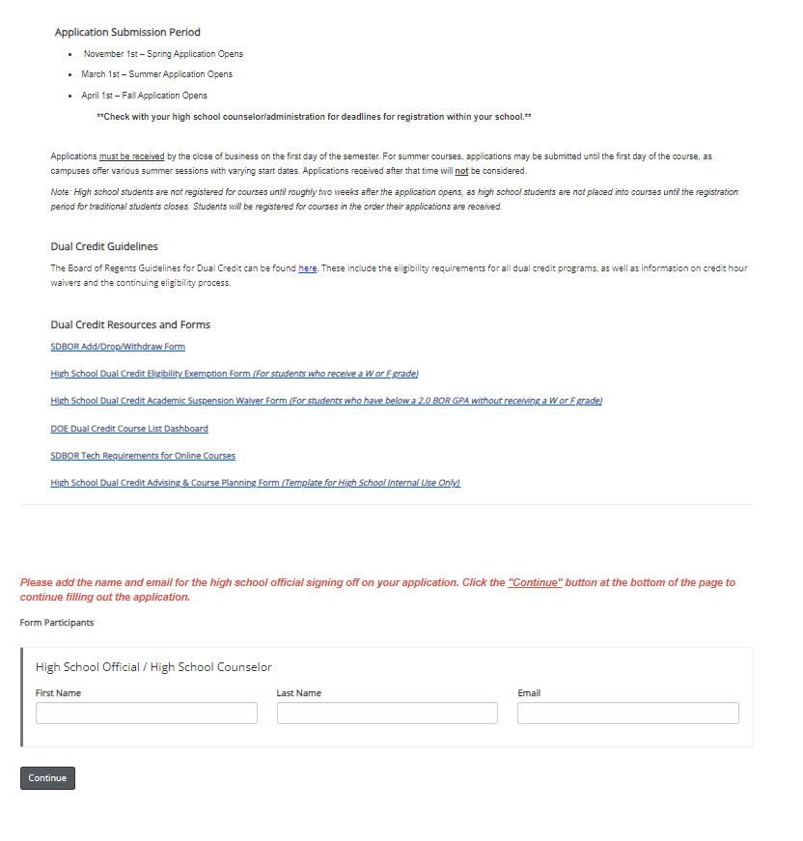
Enter your High School Counselor name and email.

Slide 9
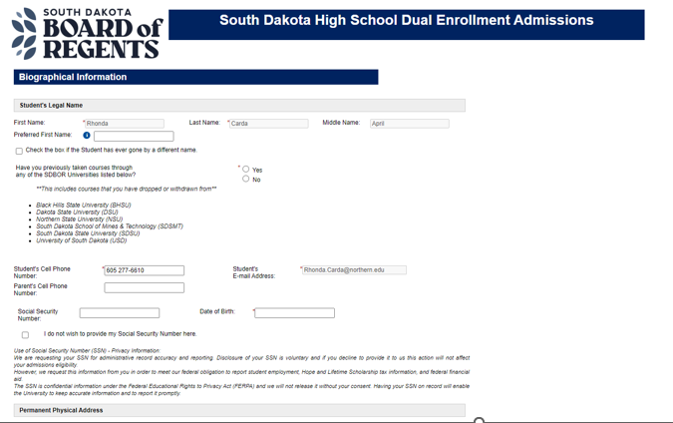
Fill out this information

Slide 10
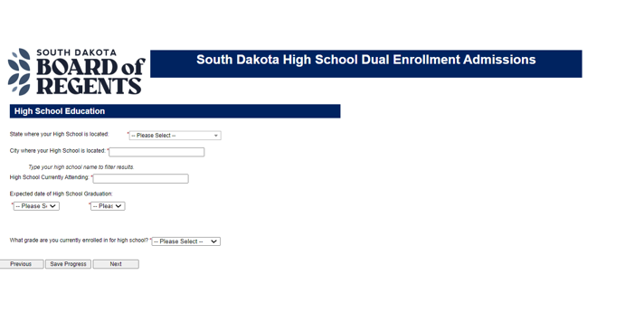
Enter information continued…

Slide 11
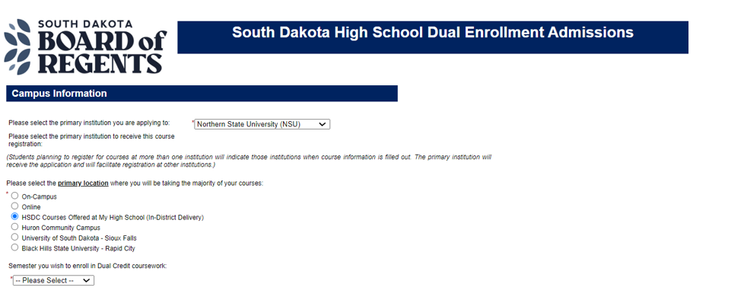
This section is for online Dual Credit classes only
You can register for
BOTH Rising Scholars and online Dual Credit courses at the same time!
Enter your RISING SCHOLARS courses in this spot. The Course Number, Title and Section Number are connected to your local high school. Refer to your HS Counselor or your Rising Scholars Academic Advisor for help.

Slide 12
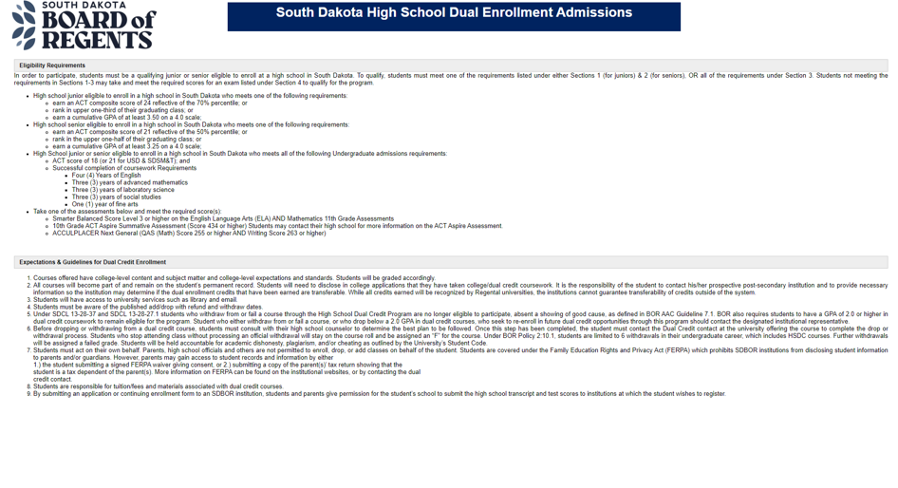
Eligibility Requirements and Expectations

Slide 13
Electronic Signatures
Acknowledgement of the SD BOR requirements

Slide 14
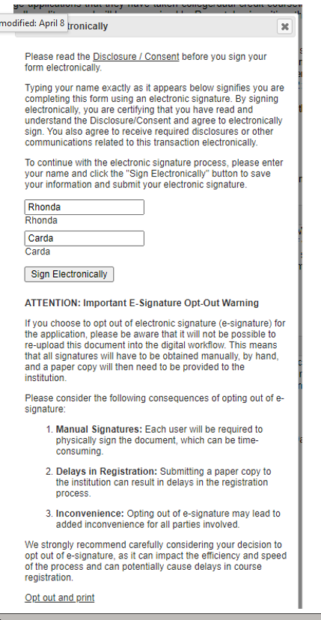
Electronic Signature
Type your name in and click on
Sign Electronically

Slide 15
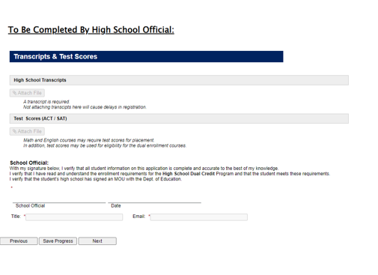
You should receive confirmation of your signature. Click Next when you see this page.

Slide 16
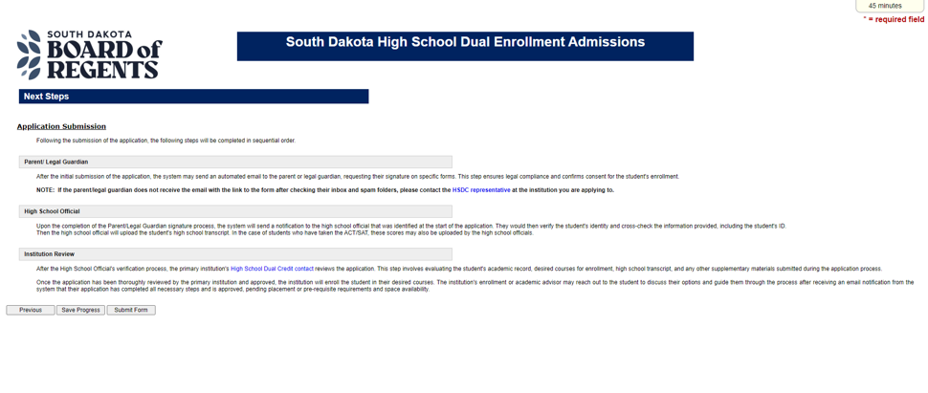
Click Submit to complete the application

Slide 17
Communicate with your parents!!!!!
Your school counselor will verify and send all test scores and transcripts.
We will wait for ACT scores to see if you qualify.
You WILL NOT have to pay at this time.
You MUST use an e-mail address you check frequently!
Register even if you do not know if you qualify or aren’t sure you want the credit. You are not fully committed to college credit until the start of the term.
There will be an additional Accuplacer testing day for those that need it.

Slide 18
Questions? Contact:
Your High School Counselor first!
Then ask Rhonda…
Rhonda Carda - Academic Advisor
for Rising Scholars
Rhonda.Carda@northern.edu
605-626-7900 (office)
Other Contacts:
Matthew Perreault - NSU Assistant Director of Admissions
Matthew.Perreault@northern.edu
Terry Piatz – Director of Rising Scholars
Terry.Piatz@northern.edu

